Slide 1



Web Scraping Real Client Project
Rahaf Alwaladi
Fares Alshalawi
Ghaidaa Hussein

Slide 2
Table of Contents
01
02
03
04
Project Overview
Project
Architecture
Conclusion
Project
Implementation

Slide 3
Project Overview
01

Slide 4
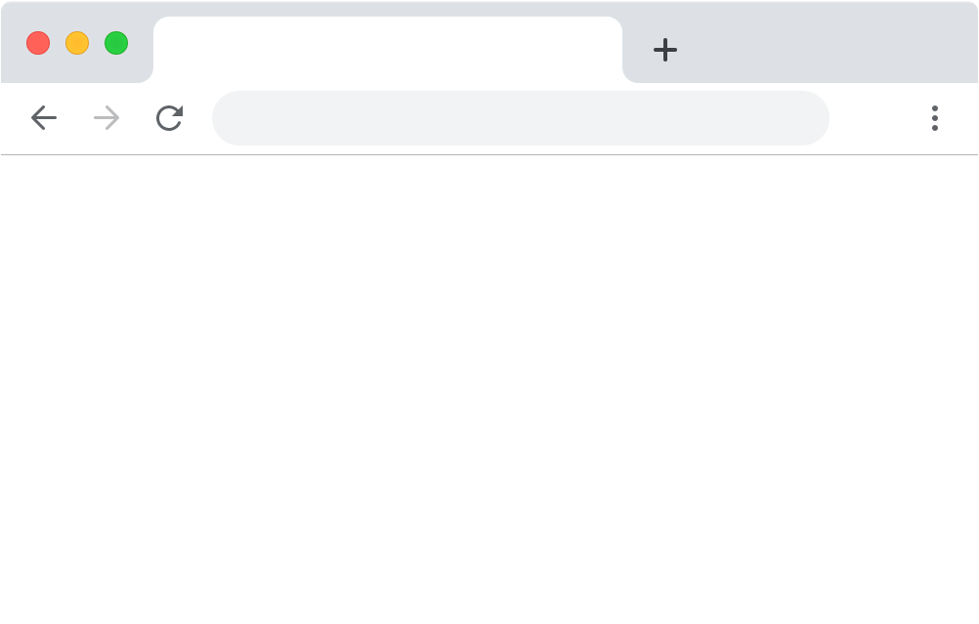
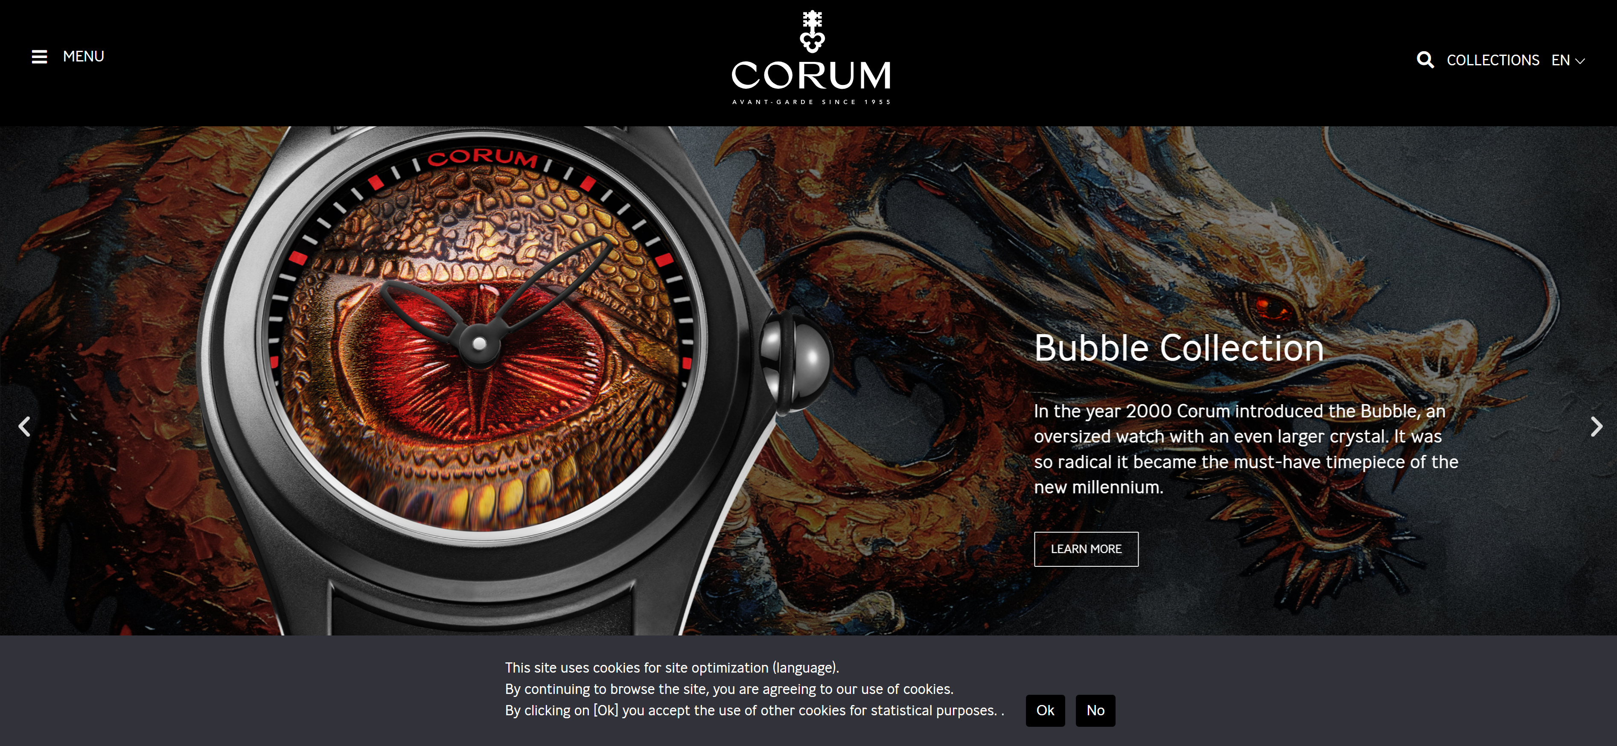
About Corum

Slide 5
Business Requirements
Extract detailed information about each watch.
Implement automated scheduling for the web scraping tasks to ensure the data is up-to-date.
Develop reports to visualize the scraped data and generate insights.

Slide 6
Project Architecture
02

Slide 7
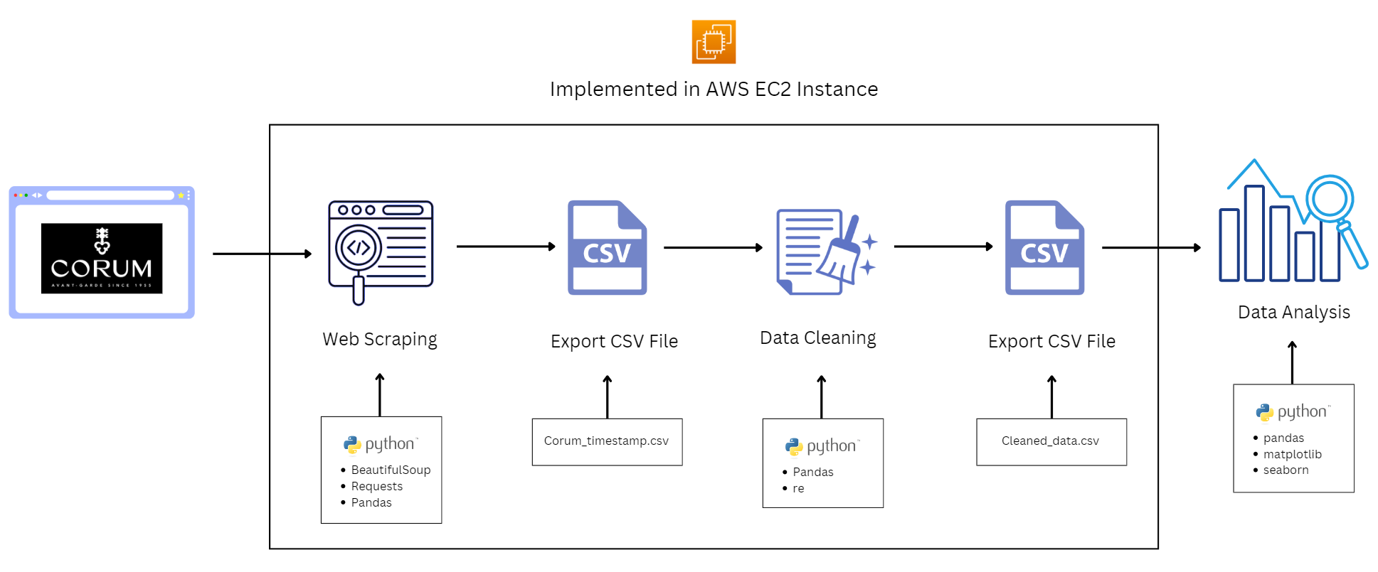
Project Architecture

Slide 8
Project Implementation
03

Slide 9
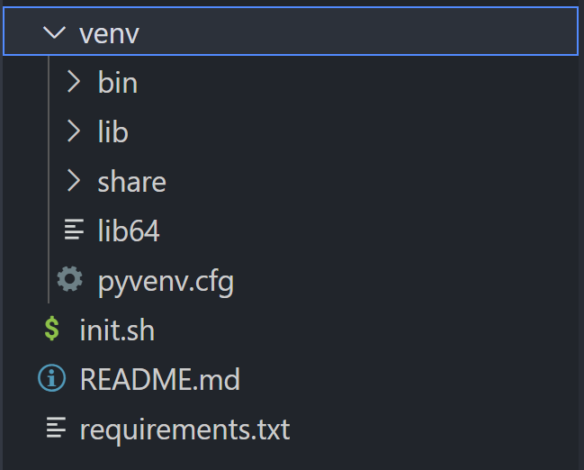
Step 1: Set up
Launch an AWS EC2 Instance
Initiate a new EC2 instance and connect it to VS Code.
Install Python
Update package lists and install Python 3.
Set Up Virtual Environment
Create a virtual environment, activate it, and install these libraries:
- BeautifulSoup4
- requests
- pandas

Slide 10
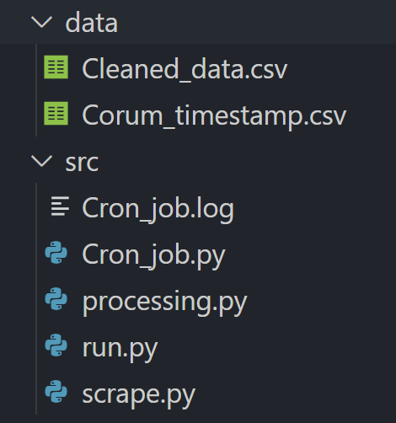
Step 2: Web Scraping
Write the Web Scraping Script (scrape.py)
- requests: For making HTTP requests to fetch web pages.
- BeautifulSoup: For parsing HTML content and extracting data.
- pandas: For storing the data, and saving it as a CSV file named Corum_timestamp.csv
Data Cleaning (processing.py)
- Drop the empty columns.
- Remove any extra HTML tags.
- Format Price column.
- Store the results in Cleaned_data.csv

Slide 11
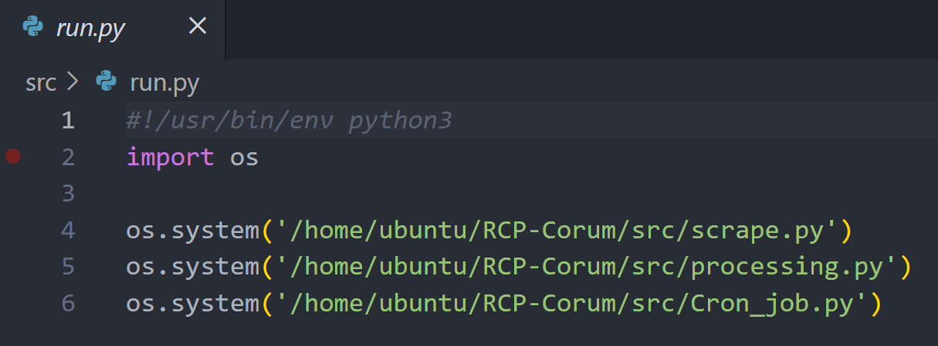
Step 2: Web Scraping
Schedule Task
run.py: prepare a script to list the required python files to be executed.
Cron_job.py: retrieves the current timestamp, and appends it into a log file Cron_job.log
Set Up the Cron Job:
Make the scripts executable (chmod +x).
Add a new Cron Job in the Crontab.
Verify and Test.

Slide 12
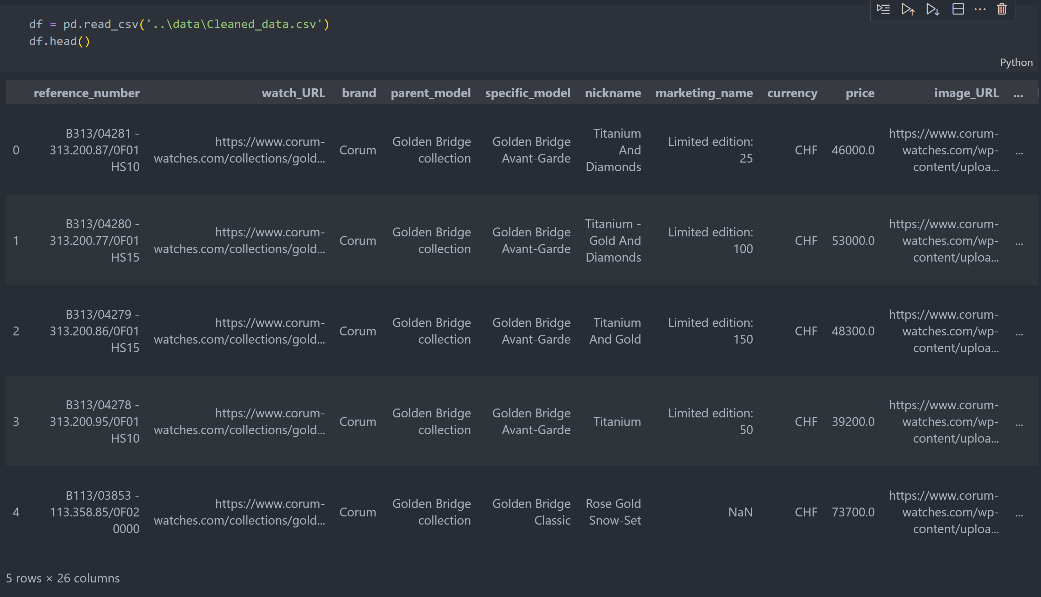



Step 3: Data Analysis

Slide 13
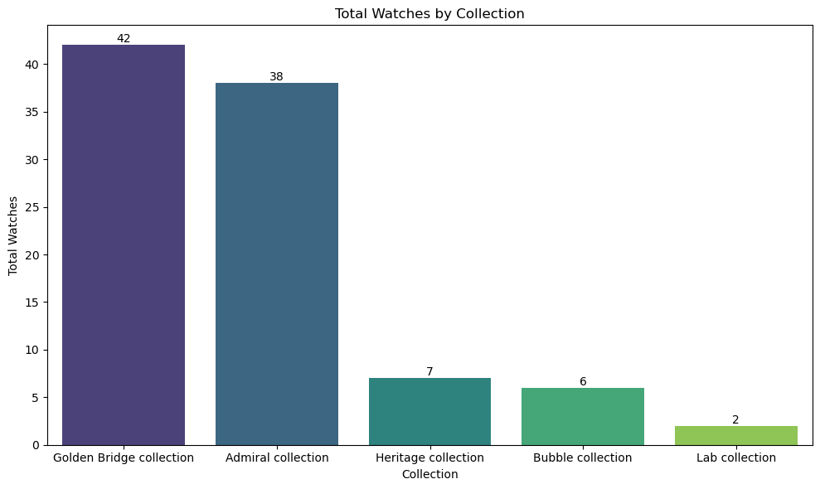
Step 3: Data Analysis
1- Total number of watches by collection

Slide 14
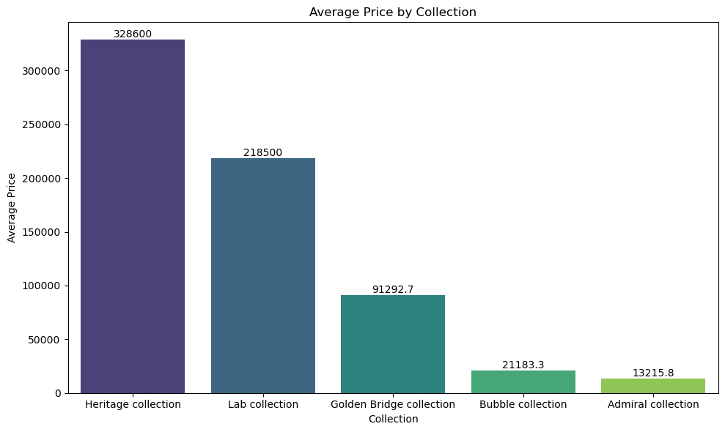
Step 3: Data Analysis
2- Average price by collection

Slide 15
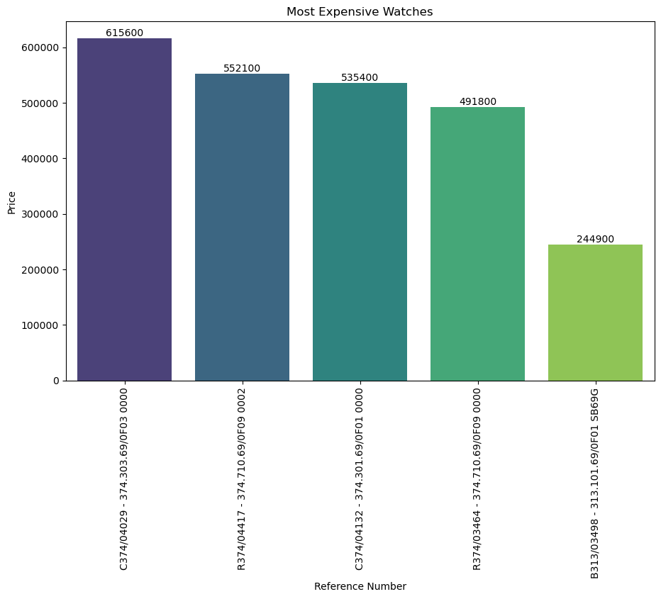
Step 3: Data Analysis
3- Most expensive watches

Slide 16
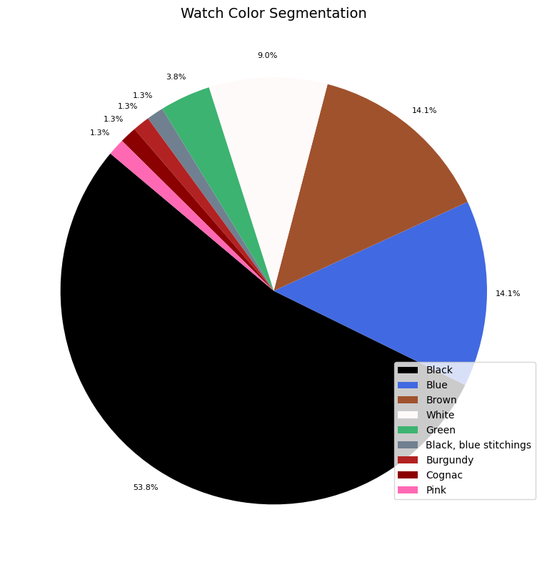
Step 3: Data Analysis
4- Watch color segmentation

Slide 17
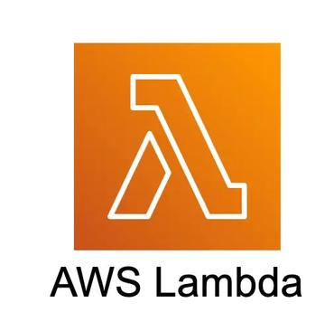

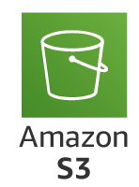
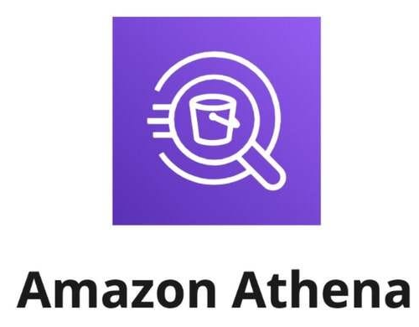
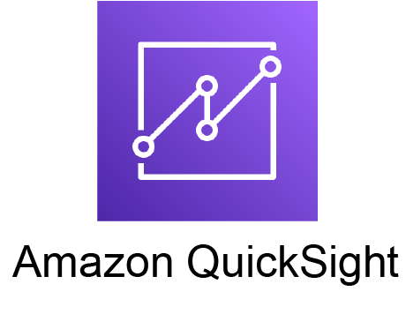
Future Work
Using lambda to do the web scraping and scheduling with AWS EventBridge.
With Amazon Athena to perform SQL queries directly on the data stored in S3.
AWS QuickSight a business intelligence service to create and publish interactive dashboards.

Slide 18
Thanks
For your attention!

